Slide 1




Batch & Stream
z
Alex Lilly, RJ Cubarrubia, Abigail Snyder

Slide 2
Project Goals
Use AWS to batch and stream data from an API
Specifically, our aim is to demonstrate a process for data ingestion that is near real time (streaming) or as new data is available at some frequency interval (batch)

Slide 3

Dataset
The EPA provides access to the Air Quality System (AQS) API that contains “ambient air sample data collected by state, local, tribal, and federal air pollution control agencies from thousands of monitors across the nation.”
This API contains data on current and forecasted air quality from a number of observation points around the U.S. (and globally)
Data (PM2.5, PM10, Ozone, CO, NOx, SOx) is updated ~hourly

Slide 4
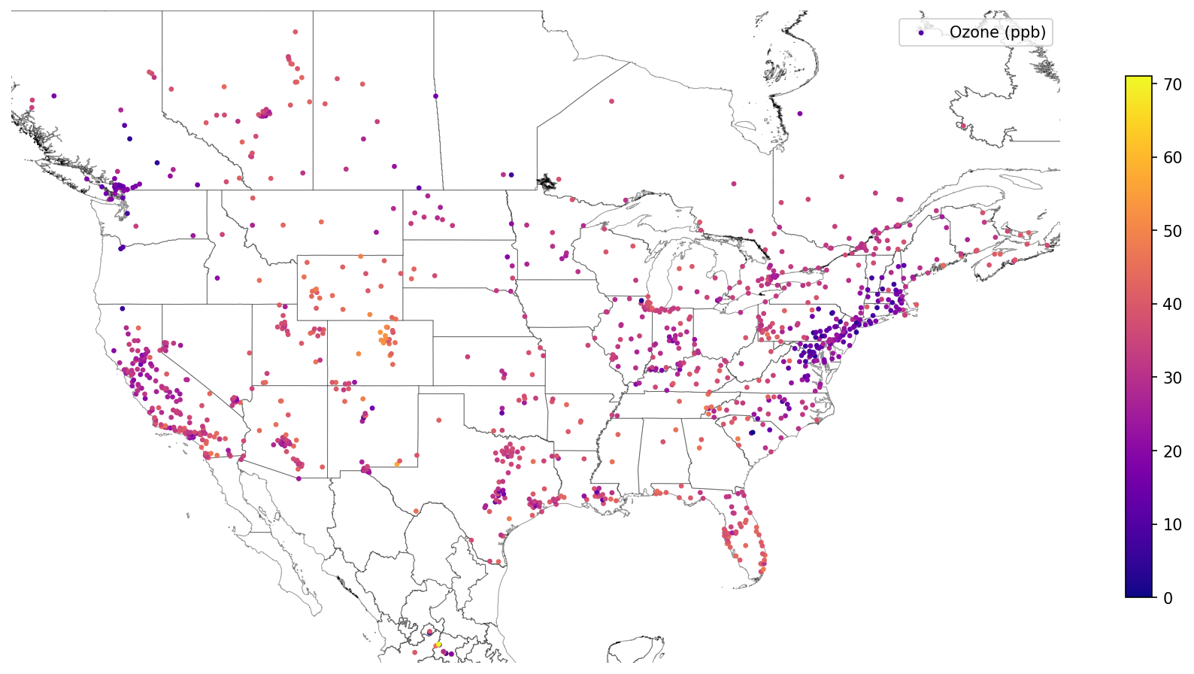
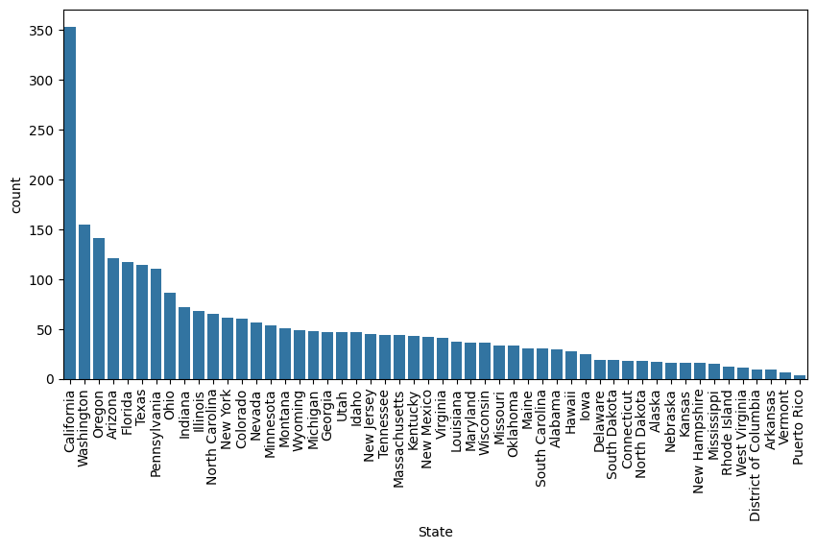
z
Dataset
~3,200 observations ​
Historical data back to 2008​
Single query limitations to ~10,000 observations. ​
Wall time = 11.7s for 5100 observations​

Slide 5
Motivation
As a result of climate change, people are more often being affected by poor air quality. Poor air quality can be detrimental to one’s health, especially with preexisting medical conditions, which influences individuals’ behavior and migration.
Air quality forecasts enable individuals to plan activities in the short term, and long-term forecasts enable long term planning.
Climate scientists can also use air quality data in conjunction with meteorological data to build climate models. These models are critical to convincing regulators of the impact and risks associated with climate change.
The air quality data stream can benefit from big data solutions to provide efficient data streaming services at scale.

Slide 6
z
Project Plan
Pull data from the API using a lambda function with a CloudWatch trigger rate
01
Import the data into an S3 bucket
02
Retrieve the data from the S3 bucket to create visualizations
03

Slide 7



Process Flow
Data-pull
lambda function
?
airnow-s3
For our project, we will create some visualizations from the stored data, but in reality, the end use of a batch & stream process like this one could be much larger—including weather or health advisories, supporting AI/ML development, or comparing measured and forecasted air quality estimates to help improve forecasting models.
CloudWatch event trigger
rate (20 minutes)

Slide 8

Project Plan
With the final presentation due on Week 14 (which is the week of April 23), our goal is to build and test the batching and streaming process by March 23 on a smaller dataset
Then, by April 6, our goal is to implement the process with the AirNow API
Finally, we will develop some visualizations from the stored data (by April 15) and prepare a presentation (by April 23).

